Slide 1
YELP DATASET Analysis
CIS 509: Analytics Unstructured Data
Team 11: Samantha Boon, Mangesh Patil, Pratik Sagar, Neha Devaru, Shao Ting

Slide 2
01
02
03
Overview
Data Cleaning
Exploratory Data Analysis
04
05
Sentiment Analysis
BERT Topic Modelling
Yelp Dataset
Merging Files
Key Findings
Summary Statistics & Graphs
Key Findings and Conclusion

Slide 3
01
Overview

Slide 4
Overview
We are consultants for a close friend, who happens to be a food critic. He is thinking of publishing a blog post for latest food trends (or things owners should focus on for their businesses) specifically catering to businesses in California who are in the food industry. This blog of his would contain information for business owners to understand the trends of the evolving customer satisfaction and preferences
As his consultants, we are curious to see if there was any unusual trends in the food industry pre-covid and post-covid using the yelp dataset business and review files and identify areas for improvement after the Covid-19 pandemic
By us helping out our close friend, this will benefit him, the food critic, in building his portfolio of sustainable improvement for businesses. He will also uncover topics and themes present in the restaurant reviews, identifying common topics discussed by customers and identify the everchanging aspects or attributes of restaurants
2018
2021
vs
Pre-covid
Post-covid

Slide 5
Focus on CA State
California

Slide 6
02
Data Cleaning

Slide 7
Data Cleaning
Filtered By
California State
Only years 2018 and 2021 (want to see before and after covid)
Only Restaurants categories
Original Datasets
yelp_academic_dataset_business.json
yelp_academic_dataset_review.json
Final Dataframe after merging and filtering
Columns : 23
Rows: 42422

Slide 8
Exploratory Data analysis
03

Slide 9
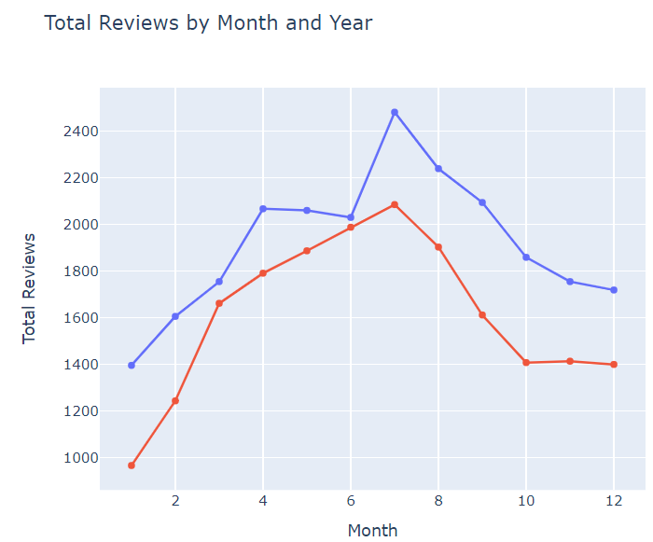
Time series Analysis by Month
Time series chart shows us the distributions of reviews over the 2018 and 2021 period respectively (there is a decrease in reviews for 2021, our assumption that this was during the covid period/slowly getting better so not a lot of people were going out to restaurants etc..)
2021
2018

Slide 10
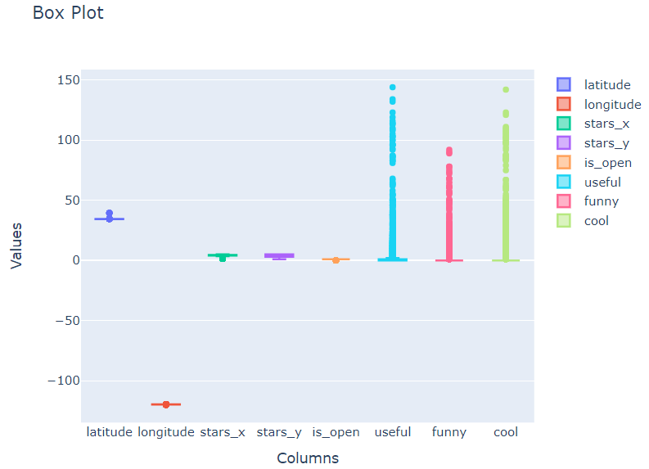
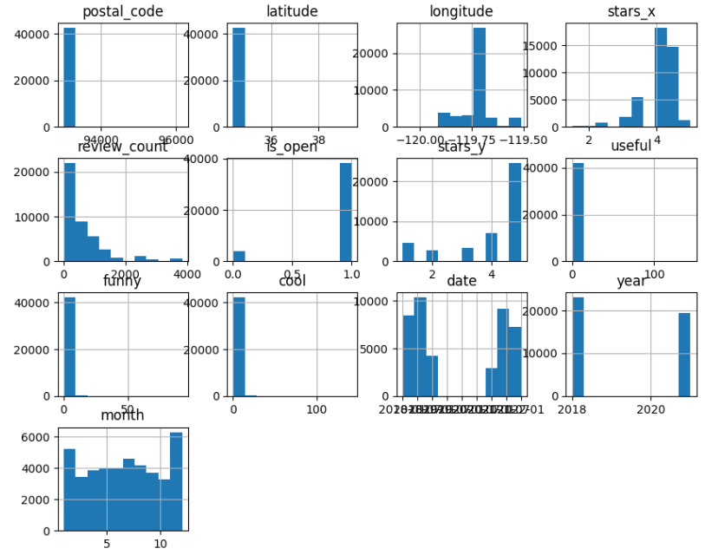
Box Plot & Bar Chart Analysis
Ran correlation graphs, but did not give us any meaningful insights (All the correlation was found between cols like funny, cool, useful, and the postal codes/longitude and latitude
No null values in the cols we used (most cols have no null values)
The cols that we ended up really using for this whole analysis was the ‘text’, ‘stars_y’, ‘date’, ‘categories’ cols in the merged dataframe

Slide 11
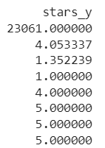
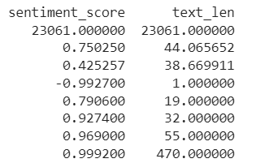
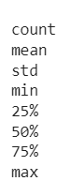
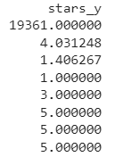
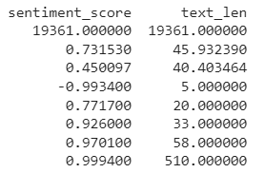
Summary Statistics
2018
2021
The cols we have here ‘sentiment_score’ and ‘text len’ was added when we conducted our sentiment analysis and Bert Topic modeling which we will touch on further in the later slides
From these summary stats, stars_y represent the customer reviews given to the business

Slide 12
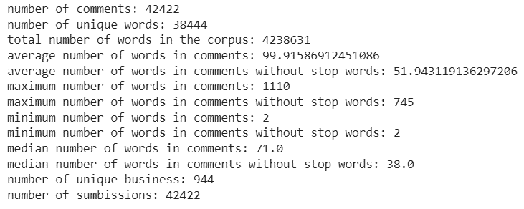
Text Exploratory Data Analysis
Text Analysis which was uncovered

Slide 13
Sentiment analysis
04

Slide 14
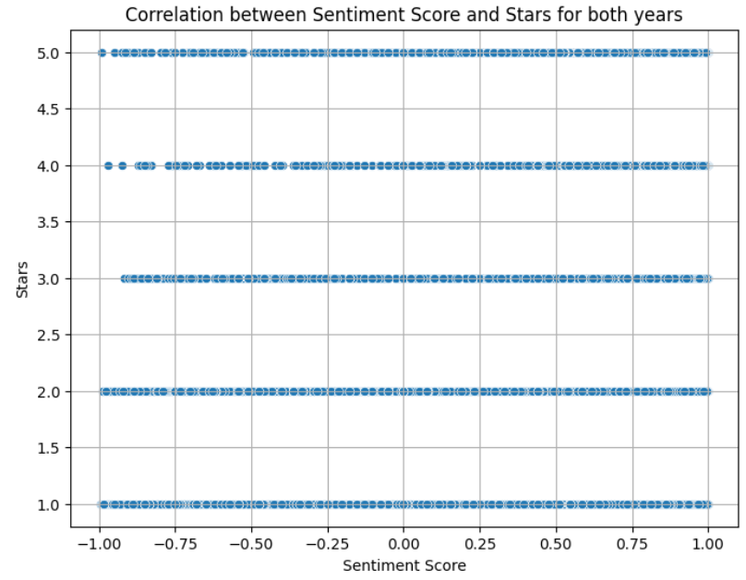
Sentiment Analysis
Text preprocessing
Lowercasing
Removing special characters (Emojis etc)
Removing punctuations
Tokenization
Remove stop words
Conduct lemmatization
New col: processed_text (Conducted Sentiment Analysis with this col using VaderSentiment)
Correlation graph between customer review stars and sentiment scores (not correlated)
Notes:
Didn't want to do sentiment analysis just based on the star rating because often times people don't know how to rate even though they give a really bad review. Hence the correlation graph above which proves out point, we manually checked through as well

Slide 15
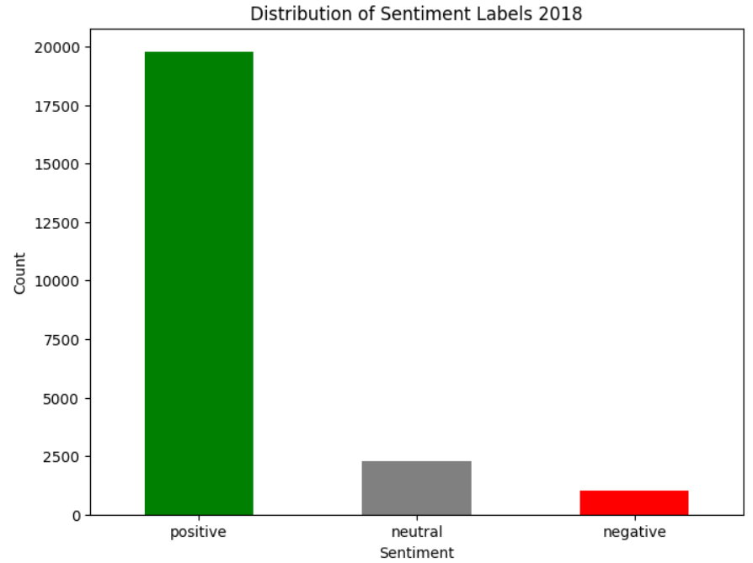
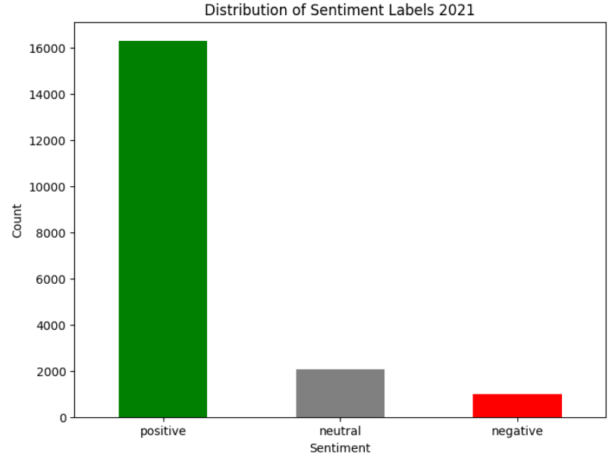
Sentiment Analysis (2018 vs 2021)
Polarity score >= 0.5 (positive)
Polarity score <= -0.5 (negative)
-0.5 <Polarity score <0.5 (neutral)
Notes:
This is the sentiment analysis we obtained respectively from 2018 and 2021 data, we mainly see similar distribution, but not as many reviews in 2021 compared to 2018
Just by looking at this chart we know that reviews decreased but in what sense? So we took one step further and conducting BERT Topic Modeling to see across all sentiments, if there is anything that we uncover that was unusual. Exp: What were the top 5 topics that people were concerned with in 2018 and 2021 respectively? Did the topics change between the two years? Did covid make any impact on the way people were writing positive/negative/neutral reviews?

Slide 16
BERT Topic Modeling
05

Slide 17
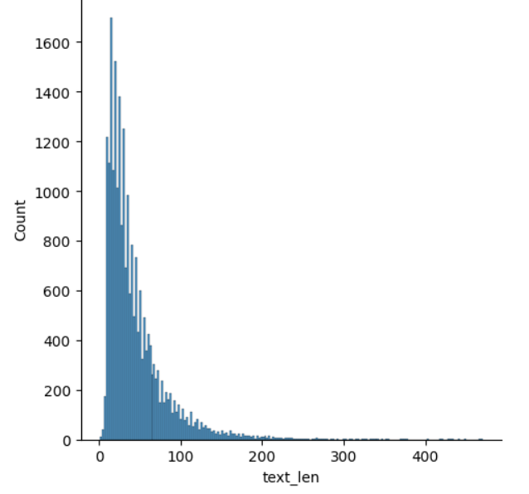
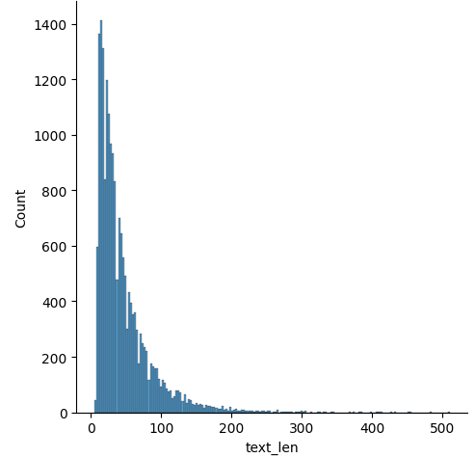
Length Distribution of Reviews
2018
2021
Longest review length: 470 words
No. of topics: 133
Longest review length: 510 words
No. of topics: 103

Slide 18
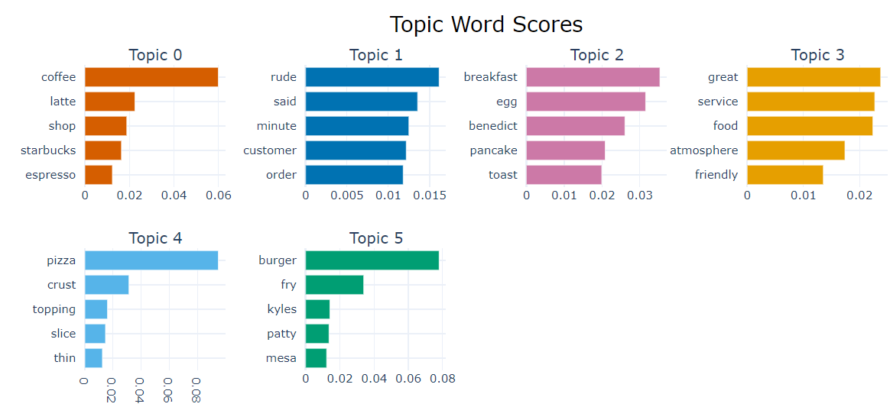
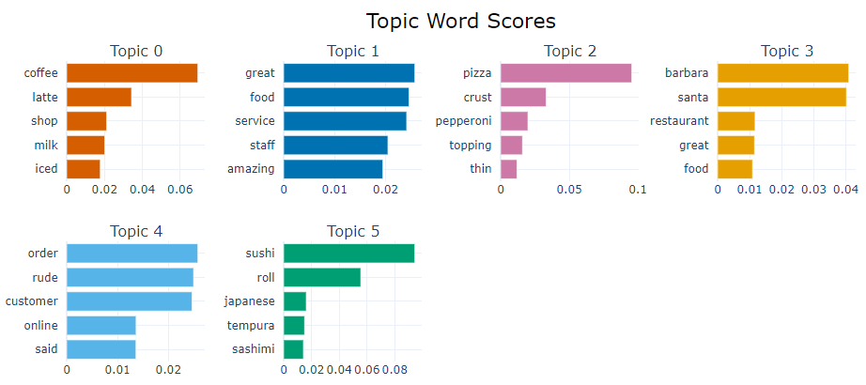
Topic Word Scores
2018
2021

Slide 19
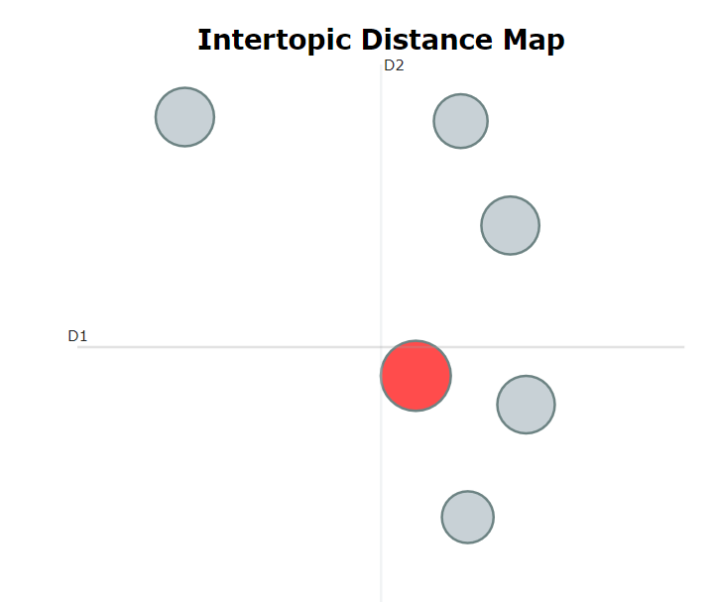
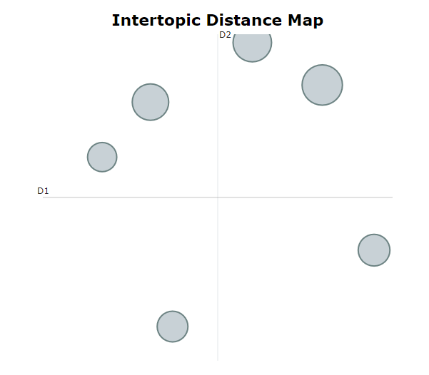
Intertropical Distance Map
2018
2021
Notes:
2018
Topic 0,3,5 clustered together (bottom right)
Topic 2,4 clustered together (top right)
Topic 1 top left
2021
Topic 0, 1 clustered together (top right)
Topic 2,5 clustered together (top left)
Topic 3 (bottom right)
Topic 4 (bottom left)

Slide 20
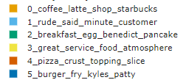
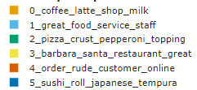
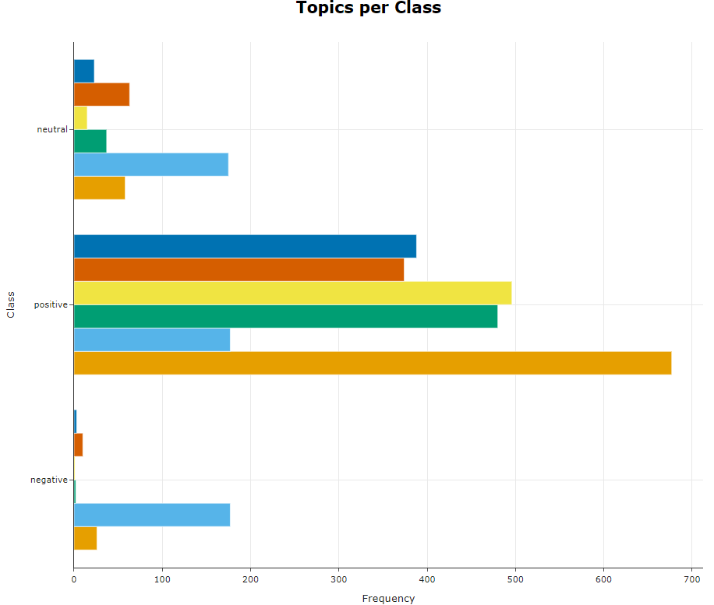
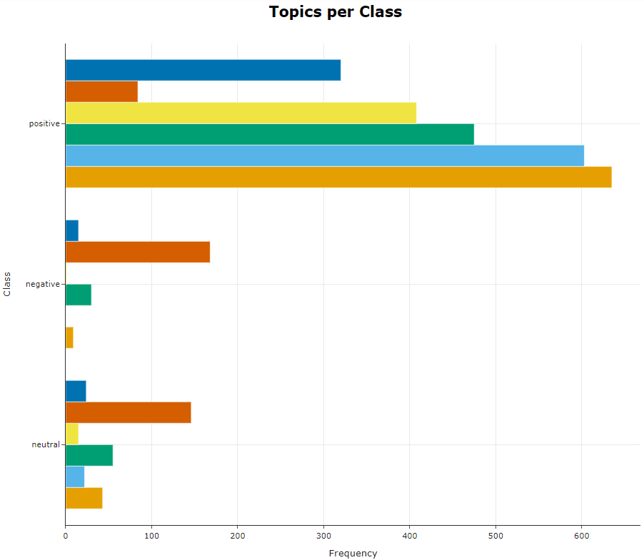
Topics per Class (2018 vs 2021)
2018
2021
Notes:
Nothing drastically changed, the topic that was present in 2021 that was not present in 2018 was Japanese cuisine, the rest compared to 2018 was somewhat similar. One possibility is that people started incorporating and trying out different cuisines in their daily lives from the boredom of being at home. Asian cuisines such as Japanese foods are also known to be prepared in a much healthier manner – it incorporates lesser fried things than other cuisines

Slide 21
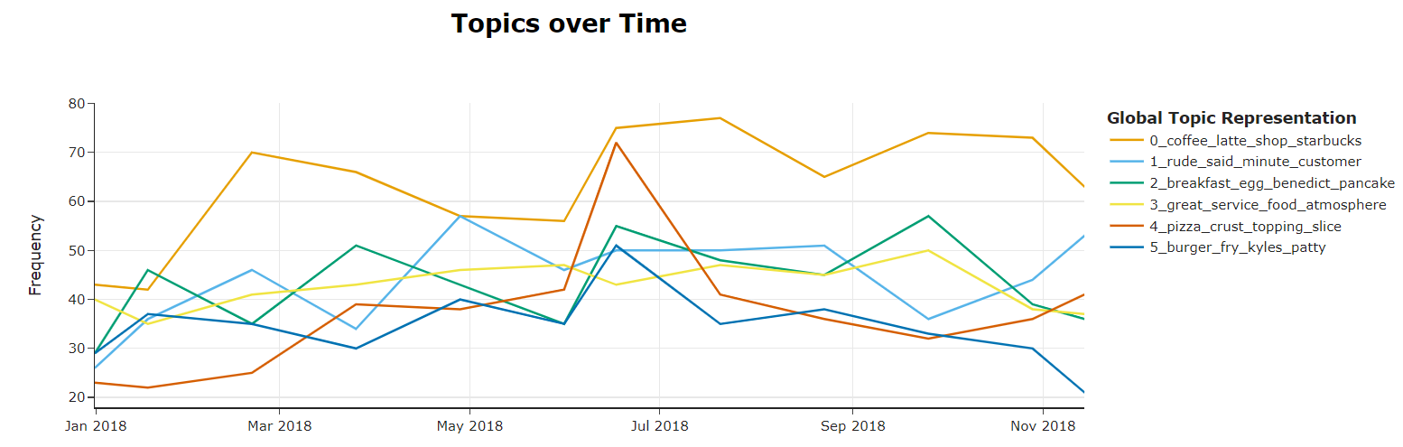
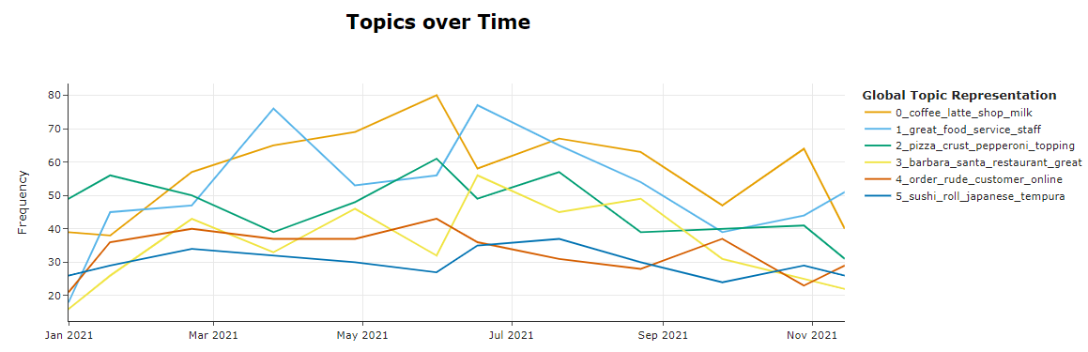
Topics Over Time Analysis (2018 vs 2021)
2018
2021
Notes:
Timeseries chart showed middle of May-July was the peak of all the topics. Which makes sense since that is the period of summer break for a lot of students. Higher tendency of spending time with family as well during this period in 2018 - coffee shops, restaurants, even after the peak in May-July, it went back to normal, people were still going out. In 2021, a lot of these topics were stable but a noticeable difference was coffee shops- the frequency of topics was not as high as compared to 2018 and started dropping off after May to July period as well. As for the peak in 2018, there was no noticeable peak in 2021 during the May to July period
Coffee shops had a noticeable difference when comparing the 2 years. It was seen to be decreasing over the months of 2021, possibility of people not going out as often with Covid to meet friends or distant family members

Slide 22
Conclusion
Review Decline
Overall Data - Decreased restaurant patronage
Coffee Shops - Shift to working from home
2018 vs. 2021 Changes
Rise in popularity of Japanese food - Associated with freshness and healthfulness
Future Steps
Identify which restaurant categories experienced the most significant drop in reviews. Delve deeper into market preferences

Slide 23
THANK YOU!

